Slide 1
Adventure Works

Slide 2
Introduction
AdventureWorks is a sample database for Microsoft SQL Server 2008 to 2014.
AdventureWorks database supports standard online transaction processing scenarios for a fictitious bicycle manufacturer - Adventure Works Cycles. Scenarios include Manufacturing, Sales, Purchasing, Product Management, Contact Management, and Human Resources.

Slide 3
Database Diagram
Dimension
Product
Geography
Date
Promotion
Reseller
Fact
ResellerSales

Slide 4
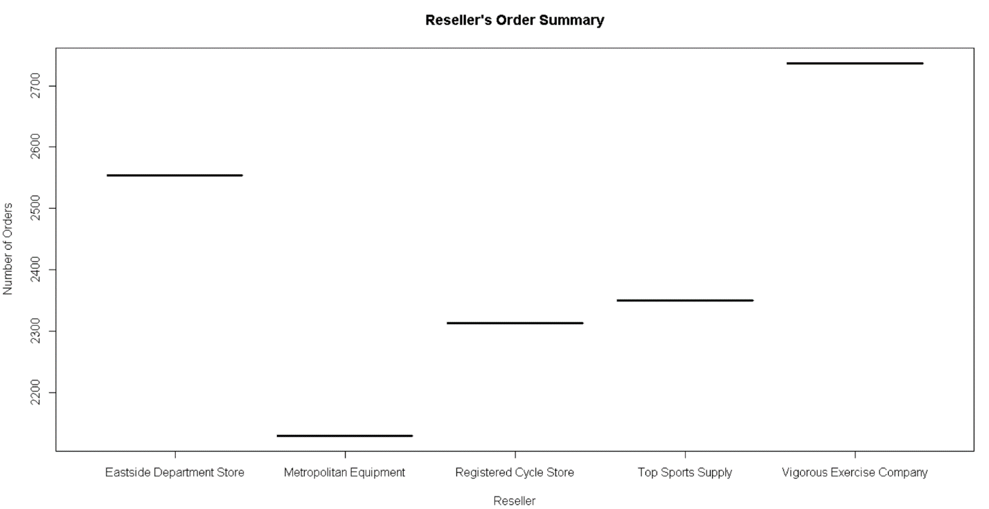
R Visualization 1
The above plot shows the Orders placed by each of the reseller in total. As can be seen from the plot Vigorous Exercise Company has the highest number of orders in place and Metropolitan Equipment has the lowest number of orders.

Slide 5
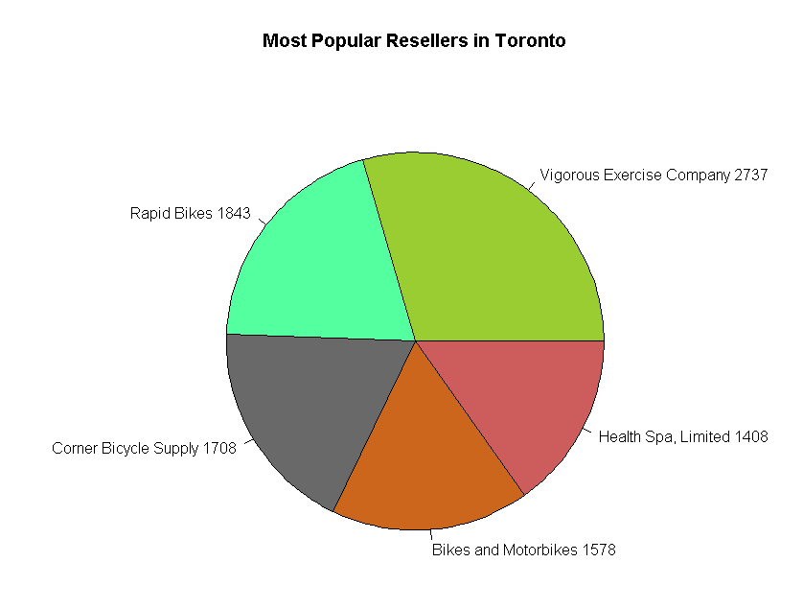
R Visualization 2
The above plot shows the most popular resellers in Toronto region. Vigorous Exercise Company once again tops the list followed by Rapid Bikes, Corner Bicycle Supply, Bikes and Motorbikes and Health Spa, Limited. The popularity between the most popular and the next best shows a huge difference indicating a higher performance from their side.

Slide 6
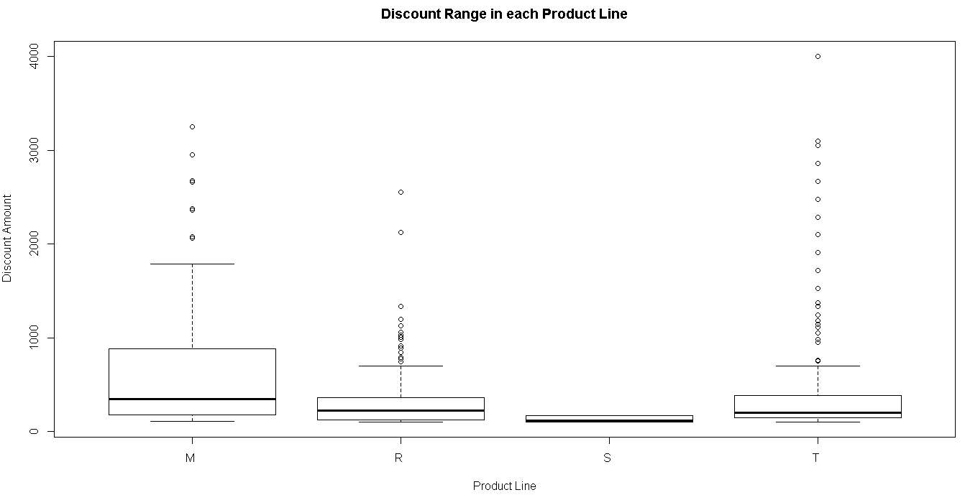
R Visualization 3
M – Mountain, R – Road, S – Sport, T – Touring
The least number of discounts were offered in the Sports range indicating a strong selling product. The touring range had most number of discounts outside the normal range indicating more number of products which were found difficult to sell. Even Road range had a few number of discounts outside the normal.

Slide 7
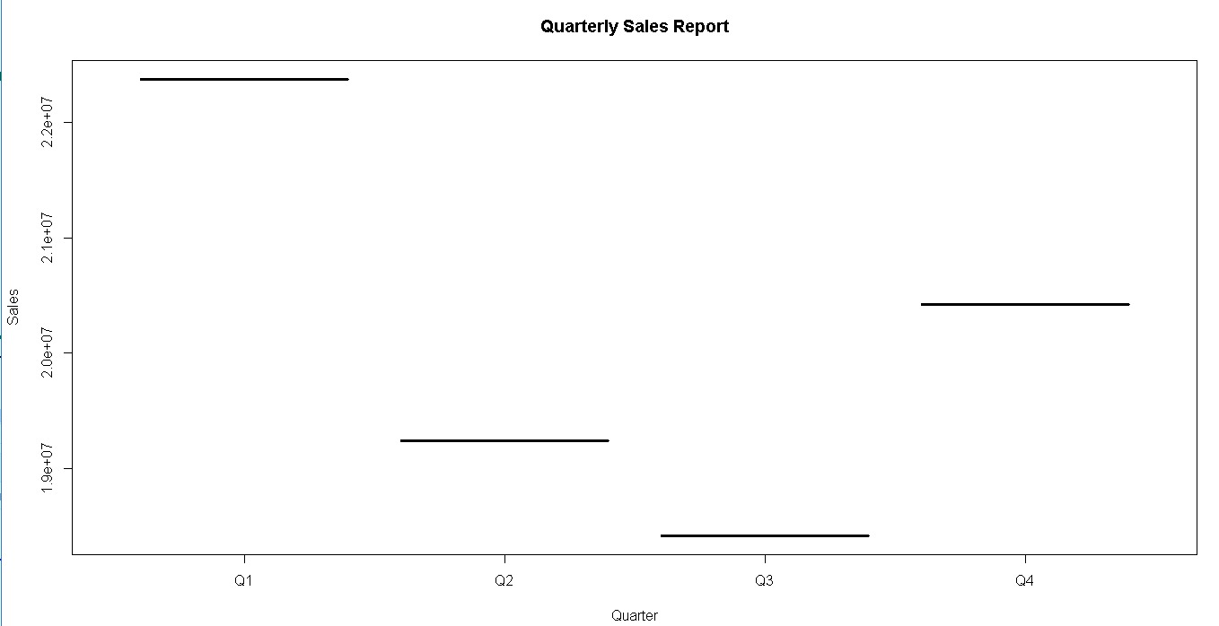
R Visualization 4
The quarterly sales report divides the total sales into four quarters and as can be seen the first quarter shows the highest performance which far exceeds the lowest selling quarter (Q3) by more than a million units.

Slide 8
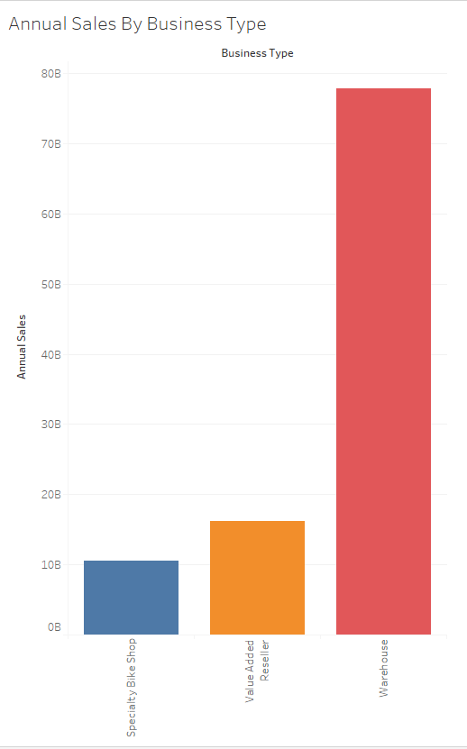
Tableau Report 1
The above plot shows that the direct sales from Speciality Bike Shops and Value Added Resellers is far outnumbered by the sales directly from the warehouse. The sales from Speciality Bike Shops is atleast 65Billion units less than from the Warehouse. This can be used as an index to focus sales strategies and discounts.

Slide 9
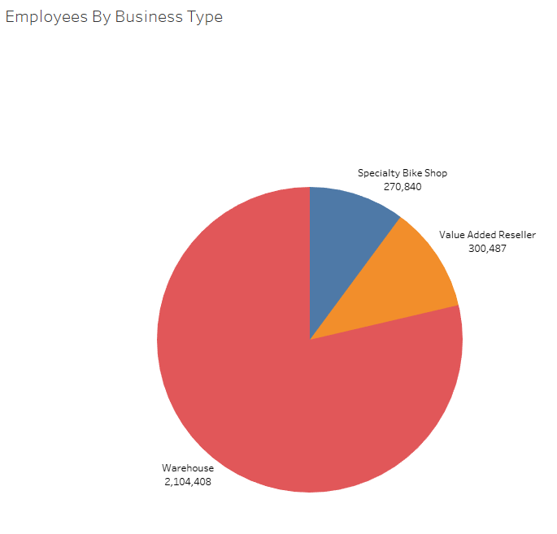
Tableau Report 2
Warehouse employs the most number of people followed by Value Added Resellers and Specialty Shops . This shows a direct relationship with the annual sales of each type of entity wherein the Warehouse had to employ more due to the amount sales they have to process annually.

Slide 10
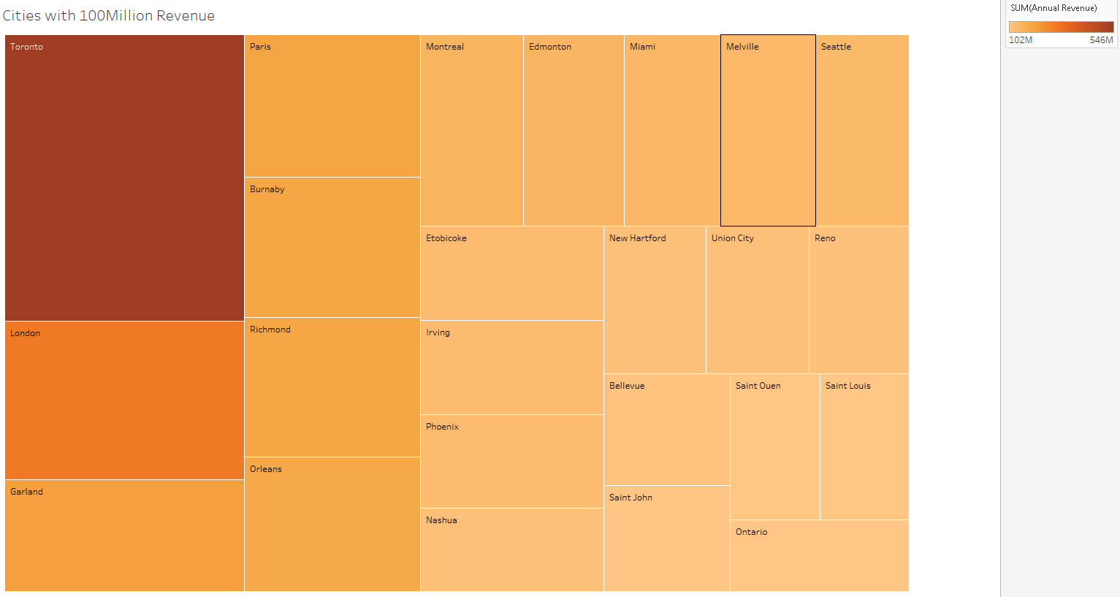
Tableau Report 3
Toronto leads the cities with London, Garland and Paris following. This can be used to offer promotions to low performing cities and bring up the sales.

Slide 11
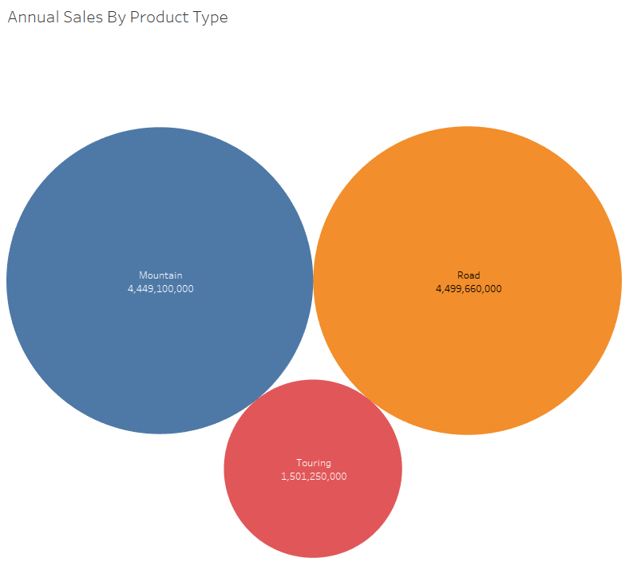
Tableau Report 4
The above bubble chart shows the annual sale of cycles by their type. This can be used to forecast and plan the production plan and selling patterns for the future. Mountain Bikes and Road going versions show more or less similar selling patterns.

Slide 12
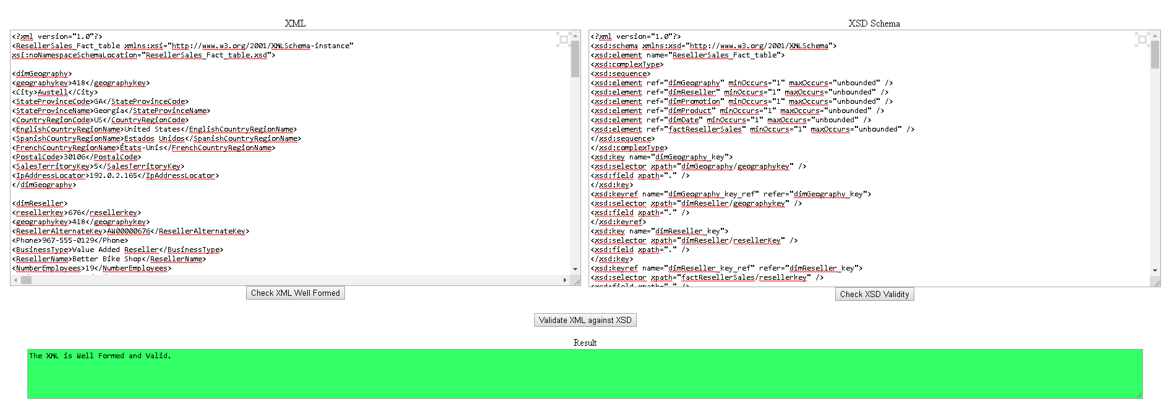
XML Validation

Slide 13
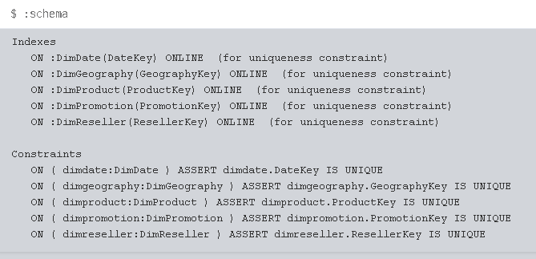
Neo4j Graph Database
Data loaded using queries
The schema shows the constraints created on all tables

Slide 14
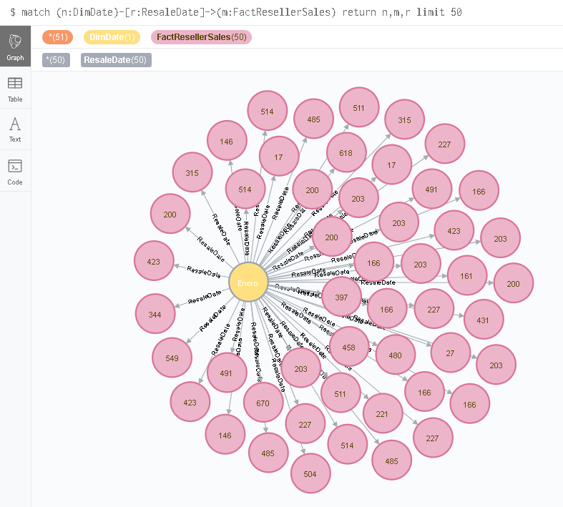
Relation 1
ResaleDate between Dimension Date and Fact table Reseller sales

Slide 15
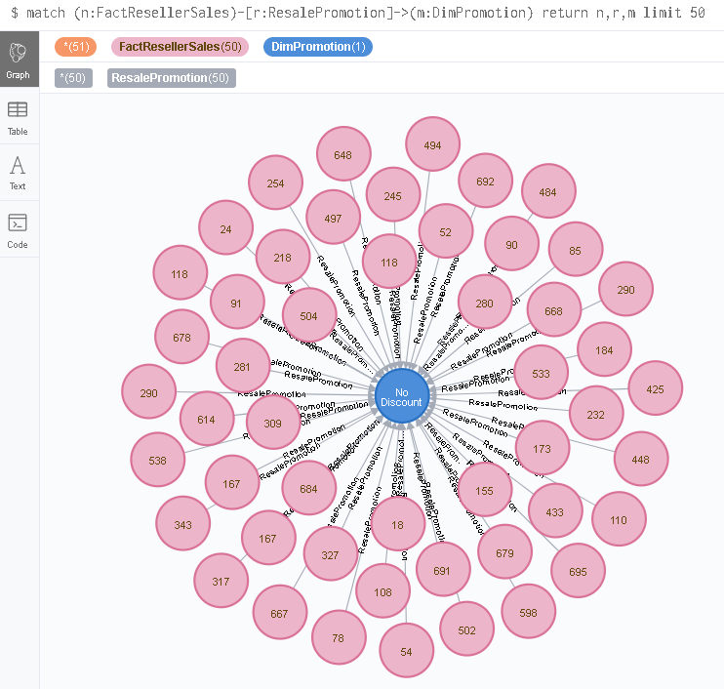
Relation 2
ResalePromotion between Fact table ResellerSales and Dimension table Promotion

Slide 16
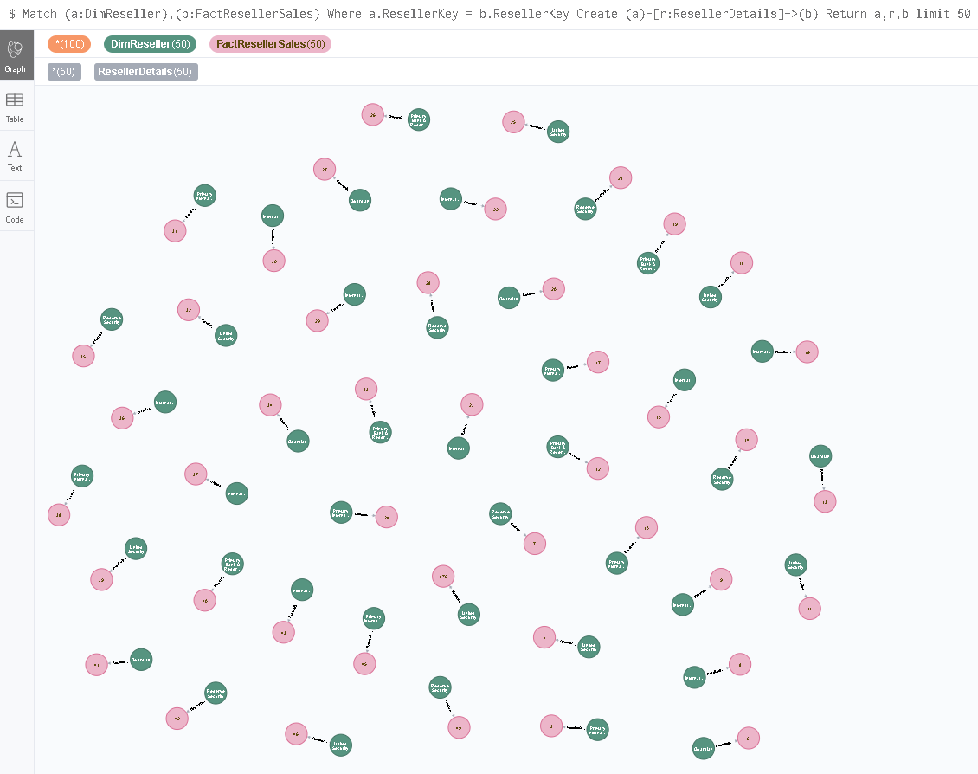
Relation 3
ResellerDetails between Dimension Reseller and Fact table Reseller Sales

Slide 17
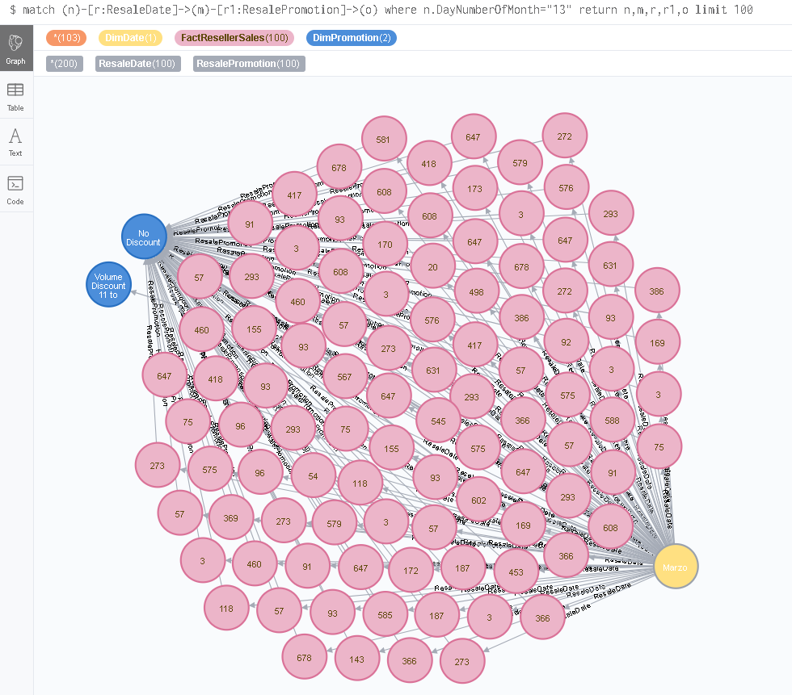
Query 1
To find Promotions of all products with resale date of 13 of any month

Slide 18
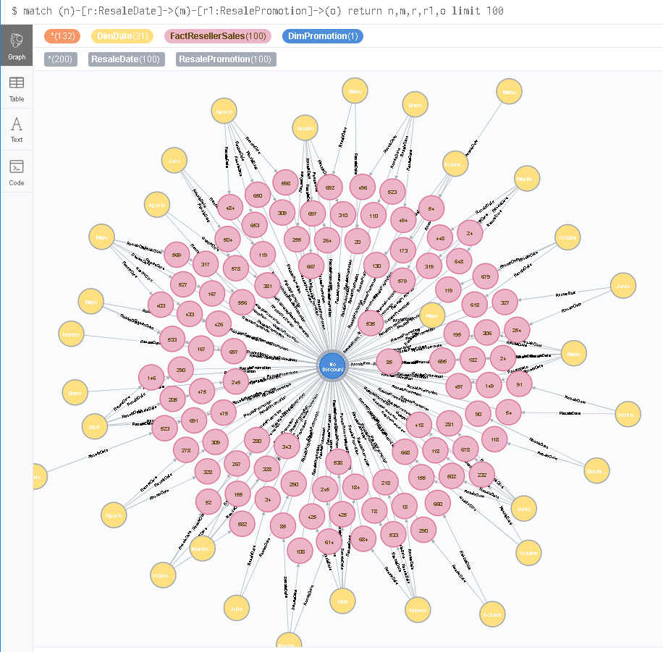
Query 2
To find all the Resale Dates with Promotion type

